Slide 1
Micro- and Macroeconomics
BMEGT30A001
Lecturer: Zoltán Bánhidi (Micro) (Friday) and Zsolt Gilányi (Macro) (Wednesday), Department of Economics
(banhidi.zoltan@gtk.bme.hu, gilanyi.zsolt@gtk.bme.hu)
Available: on request via mail, QA224.
Material (ppt presentation + text) available on moodle from week to week
Signature : On-line test on the 7th week in the time slot of the lecture 50%Micro+50%Macro
Offered grade: online test on the 14th week 50%Micro+50%Macro

Slide 2
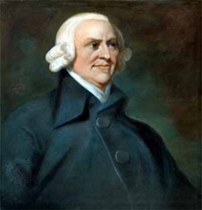
MACRO(ECONOMICS)
AIM: understand the workings of the economy in which we live
economy=economic system:
system that determines the accumulation of wealth
UNDERSTAND THE WORKINGS OF THE SYSTEM THAT DETERMINES THE ACCUMULATION OF WEALTH IN WHICH WE LIVE
A. Smith (1776):
An Inquiry into the Nature and Causes of the Wealth of Nations
Understand the workings of the system that determines the accumulation of wealth in which we live

Slide 3

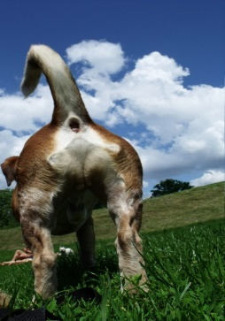



1. WAYS OF THEORIZING
► Scientifically
► Ideologically
Univocal definitions are required („check-list”)
1.1 Scientific theory building
Cats: have
tail
ears
fur
Behaviour:
- carnivore
Coherent deduction
POSTULATES
Result:
rub
hunt
Are these properties are really essential i.e. distinctive?
Test
M. Friedman!
reasonable
No
What is the behaviour of the cat/economy
Does not contradict the observations till now!
?
Reality:
yes

Slide 4



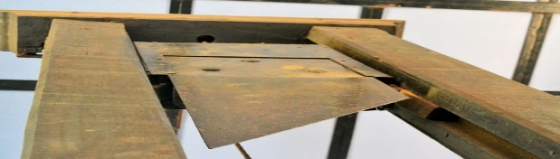

1.2 Ideology driven theorizing
„The ruling ideas of EACH AGE have ever been the ideas of its ruling class” (The Communist Manifesto, 1848)
Ideology: the explanation of the winners of the system as to why it is the "best of all worlds".
Has tail
carnivor
The system is fair and efficient
Feudalism Capitalism Socialism
Prevailing idea:
x
Liberalism
Communism
religion
Purchase on market: MONEY
CENTRAL PLANNIG BUREAU
GOD
FREE MARKET
Subordination by the force of human law
SOCIAL REFORM PROPOSAL
orchestrates the functioning of the socio-economic system with clockwork precision
end injustice
abolition of nobility
uniform people citizen
abolition of capitalists
uniform people proletarian
WHAT IS FREE MARKET?
„additional cost”
x
The univers that
The universe that GOD chose to exist is the best of all possbile worlds, otherwise it would have been unreasonable for God to create it.
(Leibnitz, 1710)
the LIBERALISTS the COMMUNISTS
chose to exist is the best of all possbile worlds …
We have the cure and the systemic characteristics without economic theory.
Then what for economic theory?

Slide 5
Understand the workings of the system that determines the accumulation of wealth in which we live
2. MINIMAL POSTULATES FOR THE STUDY OF WEALTH ACCUMULATION
► Postulate on indiviudal and social wealth (what is wealth?)
► Postulate on the ways of wealth accumulation
2.1 Nature of individual and social wealth
Social wealth = Σ individual wealth
2.1.1 Value theories / real analysis
wealthy = has many valuable possessions
valuable = exchangeable
You want it + You can only get it by giving something else to another person.
because it satisfies some human needs = useful
because you cannot have it free
= scarce
wealthy = has many useful things = commodity (good)
both individual and social wealth are manifested in goods
THUS INDIVIDUAL AND SOCIAL WEALTH ARE IDENTICAL IN NATURE (commodity)

Slide 6

2.1.2 Accounting approaches / monetary analysis
wealthy = (has many valuable possessions
+ claims – debts) expressed in monetary terms
Valuable = has positive price in terms of money
Individual wealth at time t-1 is the maximum amount of money that this individual can expect to spend in period t, ceteris paribus, after fulfilling all his contractual obligations relating to wealth and without engaging in any activity that affects his wealth (i.e. this capacity to spend money).
We call the same binding statement in the contractual obligations relating to wealth a financial asset for the holder of the statement and a financial liability for the issuer.
Binding statment
In exchange of this paper I give an apple on the spot..
agent A
signiture
Face value: quantity specified in the binding statement
All other possessions of an individual that are not financial assets (i.e. do not arise from a contractual relationship) are called real assets.

Slide 7
2.1.2
individual A
individual B
Liabilities
Binding statment
In exchange of this paper I give an apples on the spot..
agent A
Assets
Liabilities
Asset: possession (owned valuable stocks), it corresponds to some capacity to spend money
Liabilities: (your obigations)
Assets
Real asset
Financial liability
Financial asset
Individual
Wealth B
Individual
Wealth A
Real asset
Society
Financial asset//liability formally an asset/liability that is a liability/asset at the same time at another agent.
Two types: claim/debt (enforcable in terms of something other than itself) and non-claim/non-debt.
Pay (mainstream definition): honour a debt.
Real asset: formally is an asset that is not a liability at the same time at another agent (≠ good)
Assets
Liabilities
Valuable
Stocks of
the society
Real assets
Individual
Wealth A
So
ci
al
we
al
th
Individual
Wealth B
balance: the difference between the items entered into the two columns of an account
THUS INDIVIDUAL AND SOCIAL WEALTH IS OF DIFFERENT NATURE
financial assets disappear during social aggregation
The two column register on the magnitude and structure of wealth (balance sheet) or on the variation of these magnitudes expressed in a common unit of account is called account.

Slide 8
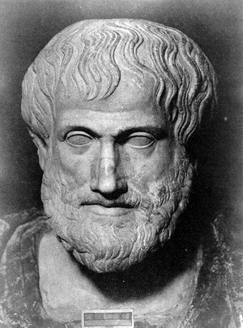

2.2 Basic behaviors that drive decisions about wealth
Aristotle: 2 major behaviors (logic/driving force) that drive individual decisions about wealth
OIKONOMIA : decision about wealth for the purpose of satisfying human needs commodity transformation for the purpose of satisfying human needs: C-(M)-C’.
Essence: C-C’
Money is inessential;
Relative prices (C/C’)
use of money for satisfaction of human needs
CRHMATISTIKÉ: the use of monetary wealth for the purpose of accumulating more
monetary wealth (money proliferation)
spending money to acquire more money: M-(C-C’)-M’
production
trade
loan
M-(C-C’)-M’
M-(C)-M’
M-M’
Money is essential;
Absolut prices (M/C)

Slide 9
2.3 The primary classification of theories on social wealth accumulation
After Adam Smith, the postulate of oikonomia became the dominant one, so the science of wealth accumulation was christened economics.
Mainstream is a synonym for dominant, which is a loose, non-scientific term.
Mikroeconomics study of individual wealth accumulation in orthodox framework
Makroeconomics study of social wealth accumulation (by postulating oikonomia + almost exclusively in orthodox framework)

Slide 10
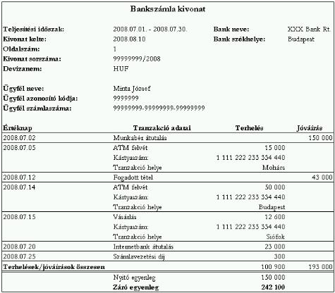
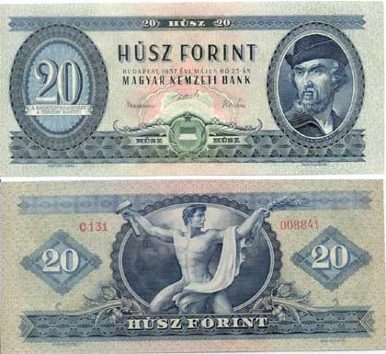
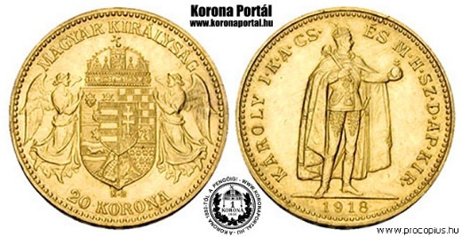
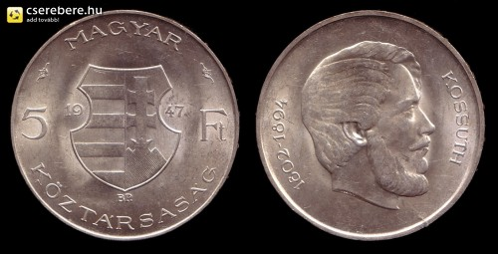
3. MONEY
Logically there is only one case where we do not need to define money: orthodox theory.
Empirically: there is money in the socio-economic system in which we live
we need money
3.1 What is money?
What are the common characteristics?
1/ its physical from does not matter
NOT PHYSICAL THING
THEN WHAT?
2/ it has a unit (HUF, $, …)
3/ it is used for payment

Slide 11

3.1
An analogy
What is rook?
1/ Without the rules of the chess it is impossible to interpret the rook! 2/ What makes the rook different from other pieces in the chess?
1/ The set of rules where money makes sense:
Payment system: social rules governing the creation and termination of contractual obligations (contractual relationship relating to wealth)
Pay: terminate this contractual obligation. In conrete terms: - honour a debt (mainstream).
2/ What makes the difference between money and other assets (means of payment)
Money is any financial assets with wich one can pay all her debts.
3
1
2
high powered money: money that is money for all the economic agents
monetary system: payment system with money
Monetary system is specified by the following rules:
Rules on payment
2. Specfication of the common unit of account
3. Rules on money creation and (destruction)

Slide 12
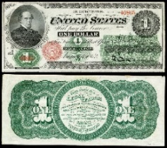
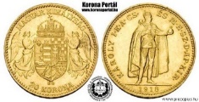


3.1
Rules on money creation and (destruction)
Two theoretical options:
► PURCHASE
Postulates
Non issuer of money
Issuer of money
A L
A L
Real asset
Real asset
Money
Money
► CREDIT (LOAN)
Bank
create money via credit operation
Non bank
Money
Loan (debt)
Loan (claim)
Money
Extinction
= return to the creator
TAX
Reimbursment of loans
Same driving force leads acceptance: the claim (loan/tax) can be paid exclusively with money.
… or petrol only for $

Slide 13



Appendix for 3.1
What is the distinctive characteristic of credit operation (financial loan)?
In money YES, but to see clearly:
agent B
Agent A
E F
E F
Non-financial loan
Statement
I owe Agent A two apples, to be paid next week.
B szereplő
debt
claim
Enforcable in terms of something other than itself– real asset!
Has maturity (must be paid in time)
asymmetric – order of execution matters
Statement
I owe Agent A a promise of two apples, to be paid next week.
B szereplő
Promise
I give an apple for this paper on the spot.
C szereplő
Financial loan
(credit operation)
debt
claim
Enforcable in terms of something other than itself– financial asset
Financial loan is not an equivalence relationship!

Slide 14
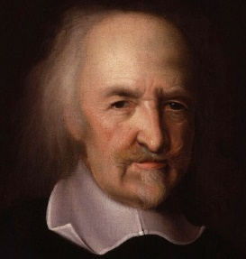
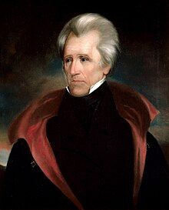
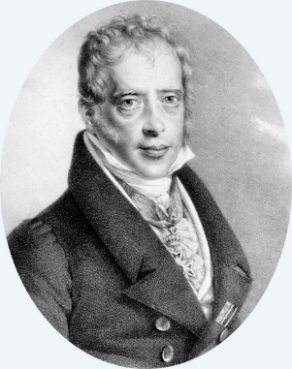
3.2 The primary importance of the control of money (monetary systm)
3.2.1 Logically
The process of wealth of accumulation is necessarily the joint action of the members of the society
Binding contractual obligations are repeatedly created and terminated.
Economics:
study of wealth accumulation
Etimology: private property
This is what economists say as production is collective: Everyone contributes to social wealth and acquires the right to appropriate part of it.
Necessarily, because of the definition of society
can get it from others
We called payment system the social rules that govern it.
which in monetary economies is
monetary system
Thomas HOBBES
(1588-1679)
Control of the money (monetary system)
Andrew Jackson (1767-1845)
7.President of the US
Wealth is power, derived from the institution of private property, to command members of society what to do through voluntary contractual obligations relating to wealth.
Command members of society
The most important power of the state is omitted:
money power
„„Give me control of a nation’s money, and I care not who makes its laws!””
Mayer Amschel Rothschild
1743-1812

Slide 15
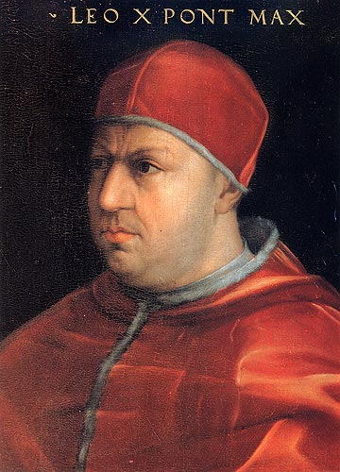

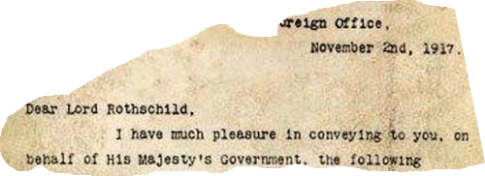
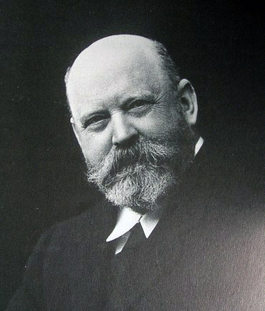
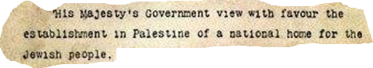
3.2.2 Some historical facts
1513: X. Leo
1513. Mars, 15: sacrificial priest,
17: bishop,
19: pope
Giovanni di Lorenzo de' Medici (1475-1521)
1519: V. (Habsburg) Karl German-Roman Emperor
Jakob Fugger
(1459–1525)
1917: Balfour declaration
Walter Rothschild (1868-1937)

Slide 16

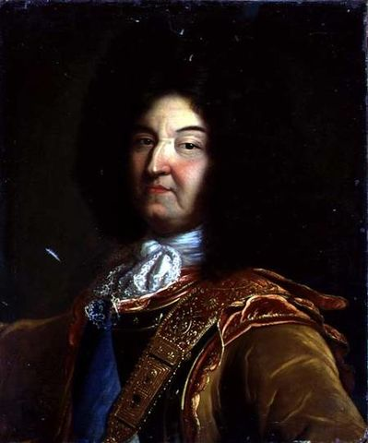

3.3 Evolution of monetary systems: from state issuance of money to private credit money system
3.3.1 Historical facts
Gold standard
Greenback
1861-1865
(Bretton Woods 1971)
Gold money system
Modern credit money
$
LOUIS XIV., Roi du Soleil (1638-1715)

Slide 17

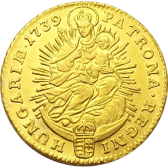
3.3.2 Evolution of monetary systems : economic analysis
1. Pure gold money system – purchase created money by the seigneur ( = state)
Gold content 0,3gr/ 1 $
charge: 0,06gr gold / coin
A Subjects L
A L
Real asset
10000$
out of which gold: 300g=833,3$
Individual wealth
10000$
Real Asset
1000$
Individual wealth 1000$
Initial state
Gold handed over to the ruler for mintage
Real asset
9166,67$
Individual wealth
10000$
Real Asset
1833,3$
out of which gold 833,3$
Individual wealth 1000$
1000$ EMISSION
Claim 833,3$
Debt 833,3$
Cost of 1000$:
300gr gold = 833,3$
Real Asset
1000$
Individual wealth 166,67$
Mintage
(gold is used up)
DO NOT CHANGE
Ruler constraints his own money sovereignty, because of fixing the gold content of coins
Debt 833,3$
MONEY 1000$
MONEY 1000$
Real asset
9166,67$
Individual wealth 10000$
Real Asset
1000$
Individual wealth 166,67$
Honour debt
MONEY 833,3$
MONEY 166,67$
MONEY 1000$
Ruler can be lack of money
Ruler can purchas for 166,67$ anyhing he whishes (seigniorage)

Slide 18
3.3.2 Evolution of monetary systems : economic analysis
1. Pure gold money system
Ruler can be lack of money: BORROW
A Lender subject L
A Other subjects L
A L
MONEY 10$
Ind. wealth 10$
Real asset
9166,67$
Ind. wealth
9990$
Real asset
1000$
Ind. wealth 166,67$
Initial state
MONEY 823,3$
MONEY 166,67$
MONEY 1000$
Loan 10$
Interest rate 10% duration 1 year
Claim 10$
Ind. wealth
166,67$
Ind. wealth 10$
Real asset
1000$
DO NOT CHANGE
time
MONEY 1000$
MONEY
176,67$
Debt 10$
Ruler spends all his money
DO NOT CHANGE
Real asset
8990$
Ind. wealth
9990$
Real asset
1176,67$
Ind. wealth
166,67$
MONEY 1000$
MONEY 1000$
Debt 10$
Ruler collects 30$ tax
DO NOT CHANGE
Real asset
8990$
Ind. wealth
9960$
Real asset 1176,67$
Ind. wealth
$196,67
MONEY 970$
MONEY $1000
MONEY 30$
Debt $10

Slide 19
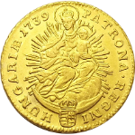
3.3.2 Evolution of monetary systems : economic analysis
1. Pure gold money system
Ruler can be lack of money: BORROW
A Lender subject L
A Other subjects L
A L
1
yar
MONEY $11
Ind. wealth $11
Real asset
$8990
Ind. wealth
$9960
Real asset
1176,67$
Ind. wealth
195,67$
Ruler honours her debt
MONEY $970
MONEY 19$
MONEY 1000$
DO NOT CHANGE
Possibility of new lending
How to increase profits in a year?
2. End of pure gold money system: birth of private banks
Use other’s money!
Banknote emission
PROMISE
I give on the spot one for this paper.
Rotschild
1 $
Rotschild
This banknote is a debt!

Slide 20
3.3.2 Evolution of monetary systems : economic analysis
2. End of pure gold money system: birth of private banks
Ruler can be lack of money: BORROW
A Lender subject L
A Other subjects L
A L
MONEY 10$
Ind. wealth 10$
Real asset
9166,67$
Ind. wealth
9990$
Real asset
1176,67$
Ind. wealth 195,67$
Initial state
MONEY 823,3$
MONEY 166,67$
MONEY 1000$
Loan 10$
Interest rate 10% duration 1 year
Claim 10$
Ind. wealth
166,67$
Ind. wealth 10$
Real asset
1000$
DO NOT CHANGE
time
MONEY 1000$
MONEY
176,67$
Debt 10$
Ruler spends all his money
DO NOT CHANGE
Real asset
8990$
Ind. wealth
9990$
Real asset
1176,67$
Ind. wealth
166,67$
MONEY 1000$
MONEY 1000$
Debt 10$
1 $ Rotschild

Slide 21
3.3.2 Evolution of monetary systems : economic analysis
2. End of pure gold money system, birth of private banks
LENDING
A Lender subject L
A Other subjects L
A L
time
Claim 10$
Ind. wealth 10$
Real asset
8890$
Ind. wealth
9990$
Real asset
1176,67$
Ind. wealth
166,67$
Initial state
MONEY 1000$
MONEY 1000$
Debt 10$
Subjects deposit 20% of their gold coins
Claim 10$
Ind. wealth 10$
Real asset
890$
Ind. wealth
9990$
DO NOT CHANGE
MONEY 200$
Banknote 200$
MONEY 800$
Banknote 200$
Lending with 10% reserve ratio for other subjects
MONEY 20$
Ind. wealth 10$
Real asset
890$
Ind. wealth
9990$
DO NOT CHANGE
Claim 190$
Banknote 200$
MONEY 980$
Banknote 200$
Debt 180$
A/ Debts are payed
B/ Again 20% of the coins are deposited and again the lender lends …

Slide 22
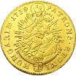
3.3.2 Evolution of monetary systems : economic analysis
Profit of lending
A Lender subject L
10% interest rate
MONEY 10$
Ind. wealth 10$
Lending in the pure gold money system
MONEY 10$
Claim 10$
MONEY 11$
10% profit/year
Lending with banknotes
10% reserve in gold coins, 20% of coins is deposited
A/ Lending once (out of deposit)
MONEY 10$
Claim 190$
MONEY 29
190% profit/year
200$
Rotschild
20+209-200
Reserve+reimbursment+conversion of banknotes
B/ Lending again and again out of depositied coins …
Multiplier effect
MONEY 10$
200$=20% of all coins deposit→10% reserve: 200/01=2000 banknote
2000$
Rotschild
200 (1000*0,2) +200*0,9 +…. =200/(1-0,9)=2000$
1st deposit 2nd deposit („replenish” to 200)
loan=10(initial)+2000-0,1*2000
Claim 1810$
=10+200*0,9+(200*0,9)*0,9+… =10+180/(1-0,9)=1810$
1st loan 2nd loan
MONEY 191$
=200+1991-2000=191
1810% profit/year!!

Slide 23

3.3.2 Evolution of monetary systems : economic analysis
Profit of lending
If „only” doubles her money (100% profit rate)
Place one grain of wheat on the first square, two on the second, four on the third and so on, double the number of grains on each subsequent square - told Sissa – and the wheat placed on the board is my reward.
This is a modest request. – the king smiled.
Price of the chess=1+2+2²+…+2⁶³
If the lender just doubles his 1$ over 63 years : 2⁶³= 9 223 372 036 854 775 808 =9,2*10¹⁸
In evidence, this is impossible; however illustrates the strong wealth concentration effect of lending.
End of pure gold money system, birth of private banks : banknote and lending
PROPOSITION
If the State is indebted toward private agents, then banknotes (bank’s debt enforcable in terms of high powered money) issued by these private agents necessarily become money; the state de facto looses its money power.
Because …

Slide 24
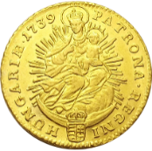



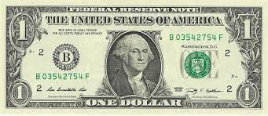
x
3.3.2 Evolution of monetary systems : economic analysis
Pure gold money system
Ruler (state)
high powered money
Lender
private debt → private money
PRIVATE PROBLEM
Fractional reserve – often bankrupcies
+
80$
Rotschild
SOCIAL PROBLEM
bank is insolvent = bank’s debt disappears = money disappears → monetary economy stops well-functioning
Solution:
SOLUTION IN THE INTEREST OF THE COMMUNITY: exclusive and unlimited money power for the public, where money is not linked to anything (ex. precious metal).
SOLUTION IN THE INTEREST OF PRIVATE BANKERS: Gold standard monetary system
3. Gold standard monetary system
4. Two tier banking system
Central Bank
The private bank of privat banks disguised as national bank
As they exist today, the role of central banks is to maintain the "financial stability" of the private banking system.
1694-: Bank of England
1791-1811: First Bank of the United States;
1816-1836: Second Bank of the United States;
1913-: Federal Reserve System
Right to issue paper money backed by gold
exclusive right to issue paper money
Not allowed to lend to the government (as a main rule)
1971 Bretton Woods: $ is not linked to gold anymore
main lender of the government

Slide 25
3.3.2 Evolution of monetary systems : economic analysis
Parallels:
pure gold money system – gold standard – modern private credit money system
high powered money
+
Money of account created by the central bank
Reserve
Money of account created by the commercial bank
Deposit
private debt disguised as public
private debt
80$
Rotschild
1971 Bretton Woods -

Slide 26

3.3.2 Evolution of monetary systems : economic analysis
1971 Bretton Woods -
4. Modern credit money system
Central bank
CB loan
(claim)
Cash
Monetary base / High powered money
Money for all economic agents
Reserve
R
Commercial banks
BANK
Two tier banking system
Loan
(claim)
LB
Money
Deposit
D
CB loan
(debt)
R
R
CB loan
(debt)
Cash
Non bank agents
Money
Cash
Loan
(debt)
MONEY (M)
Money for non bank agents
D
Deposit

Slide 27
3.3.2 Evolution of monetary systems : economic analysis
4. Modern credit money system (without cash): government loan
Tousend billion HUF
Central bank
Is the central bank able to restrict the money creation of private banks by refusing lending to them?
CB loan
R_{Bank}
HUNGARY
Government bonds held by commercial banks_{2024jan}= 11,9
R_{2024jan}=10,5
Cash_{2024jan}=8,1
Thus, the quantity of (potential) reserves is enough for 1,5 times as much money stock
CB loan
R_{Bank}
Bond_{gov}
R_{gov}
Commercial banks
For that eventuality central bank should not accept government bonds.
→ NO
Claim
D
Government
R
CB loan
R_{Bank}
CB loan
Bond_{gov}
D
R_{gov}
Bond_{gov}
Access to extra reserves
R_{Bank}
D
Non bank private agents
States have no right to create money via purchase = treasury has no right to take loans directly from the central bank
D
Debt
D

Slide 28
3.3.2 Evolution of monetary systems : economic analysis
LOANS MAKE DEPOSITS
Central bank
(Post-Keynesian explication
Cash simplified away
CB loan
(claim)
R
Commercial banks
Loan
LB
Deposit
R
CB loan
(debt)
Non bank agents
Deposit
Loan

Slide 29
3.3.2 Evolution of monetary systems : economic analysis
AND NOT DEPOSITS MAKE LOANS
(money multiplier)
Central bank
CB loan
(claim)
R
(standard explication)
Cash simplified away
Commercial banks
Claim
LB
Deposit
R
CB loan
(debt)
Non bank agents
Deposit
Debt
BECAUSE

Slide 30
3.3.2 Evolution of monetary systems : economic analysis
BECAUSE (1)
Clearing (settlement of mutual debts) is possible in principle without reserves among commercial banks!
NO NEED FOR RESERVES BEFORHAND TO CREATE MONEY
Agent (B) takes a loan
and transfers 100 $ to agent (A).
Afterwards, agent (A) transfers 100$ to agent (B’).
Central bank
Commercial bank (A)
Commercial bank (B)
claim
LB
D
claim on Bank (B)
D
D
Debt to Bank (B)
D
Debt to bank (A)
Claim on bank (A)
D
Non-bank agent (A)
Non-bank agent (B)
Non-bank agent (B’)
D
D
debt
D
D

Slide 31
3.3.2 Evolution of monetary systems : economic analysis
BECAUSE (2)
Out of $200 in coins, the lender can only lend $180, while the reserve in coins is 10%?? What is the reserve ratio for the first loan?
In this example, the loan is in coins only. Banks now lend only in cash?
1000$ coins, 10% reserve in gold coins, 20% of coins is deposited
B/ Lending again and again out of depositied coins …
Multiplier effect
MONEY 10$
200$=20% of all coins deposit→10% reserve: 200/01=2000 banknote
2000$
Rotschild
200 (1000*0,2) +200*0,9 +…. =200/(1-0,9)=2000$
1st deposit 2nd deposit („replenish” to 200)
loan=10(initial)+2000-0,1*2000
Claim 1810$
=10+200*0,9+(200*0,9)*0,9+… =10+180/(1-0,9)=1810$
1st loan 2nd loan
MONEY 191$
=200+1991-2000=191
1810% profit/year!!

Slide 32

3.3.3 The evolution of monetary systems: the directions not taken
SOLUTION IN THE INTEREST OF THE COMMUNITY: exclusive and unlimited money power for the public, where money is not linked to anything (ex. precious metal).
SOLUTION IN THE INTEREST OF PRIVATE BANKERS: Gold standard monetary system
4. Alternative monetary systems in the past: proposals and exisiting ones
1. Chicago plan
2 Free money
3. Greenback

Slide 33
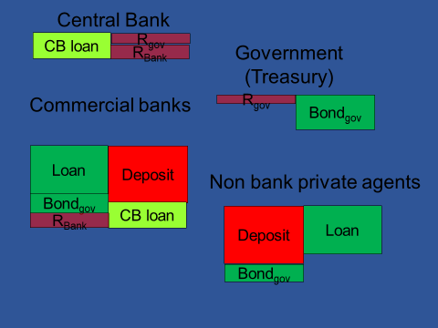
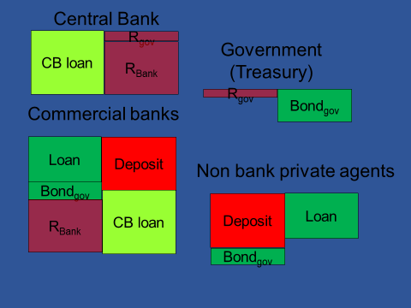
3.3.3 The evolution of monetary systems: the directions not taken
1 Chicago plan (1933)
Economic fluctuations can be reduced by separating credit and money, i.e. the existence of money does not presuppose the existence of loans.
Henry Simons, Irving Fisher
The state would take back the monopoly of money creation and its benefit.
Abolish private banks’ right to create money.
(= abolish private banks.)
Present situation
► 100% obligatory reserve rate
HOW TO IMPLEMENT?
Simplification: No cash

Slide 34
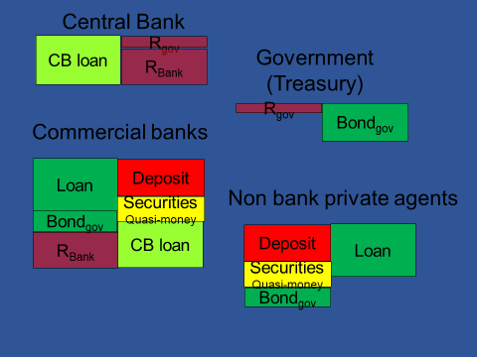
3.3.3 The evolution of monetary systems: the directions not taken
100% obligatory reserve rate is not effective: quasi-money
► 100% obligatory reserve rate +
► PROHIBITED for commercial banks to sell securities enforcable in terms of high powered money to the public

Slide 35

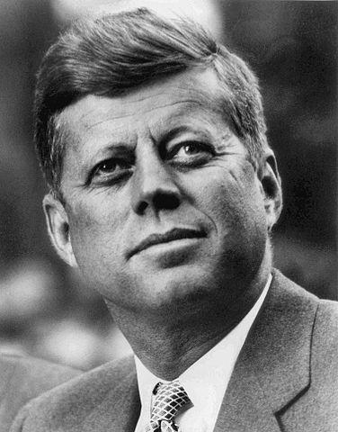
3.3.3 The evolution of monetary systems: the directions not taken
Economic fluctuations can be reduced by separating credit and money, i.e. the existence of money does not presuppose the existence of loans.
1 Chicago plan (1933)
The state would take back the monopoly of money creation and its benefit.
Abolish private banks’ right to create money.
(= abolish private banks.)
Heresy
Had he similar heretic ideas?
HOW TO IMPLEMENT?
► 100% obligatory reserve rate
► + PROHIBITED to issue bank securities encorcable in terms of high powered money to the private sector
CHICAGO SCHOOL (1970-)
AWARDED BY NOBEL PRICE
MONEY IS INESSENTIAL (Milton Friedman)
MONEY IS NEUTRAL (Robert Lucas)
Further benefic effects:
makes possible tax reduction and accordingly tax distortions;;
reduction of total outstanding loans (private+public; induced by the transactions demand for money) → credit risk decreases → loan price decreases → enhance economic activity.

Slide 36
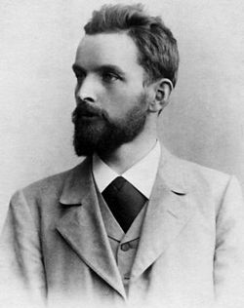
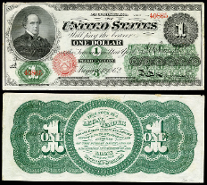
3.3.3 The evolution of monetary systems: the directions not taken
2 Free money (1916) proposal
Free money (monetary reform): money created via purchase by the state that steadily „evaporates”
make money similar to commodities to end asymmetric (monopol) situation : make it perishable
Silvio GESELL
3 Greenback, American Civil War, 1861-1865)
Money created via purchase by the state, not linked to gold
3.3.4 The evolution of monetary systems: new trends
Central Bank Issued Digital Currency CBDC)
Crypto moneies (ex. bitcoin) – not money here

Slide 37


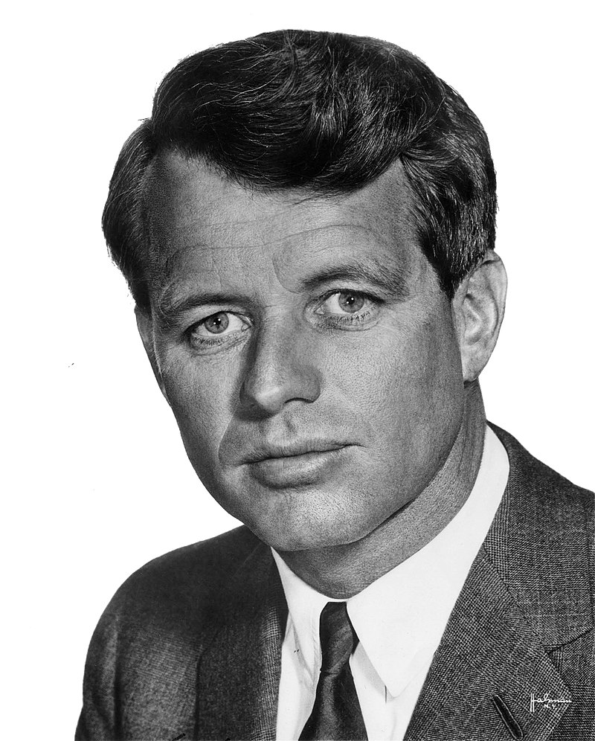
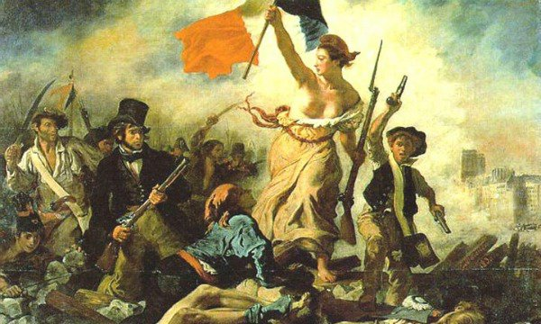
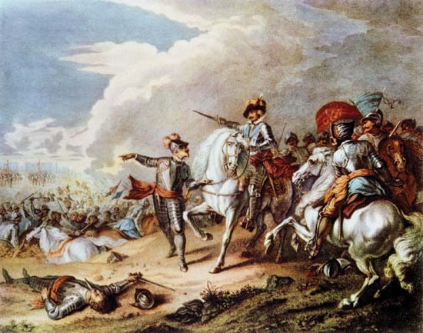
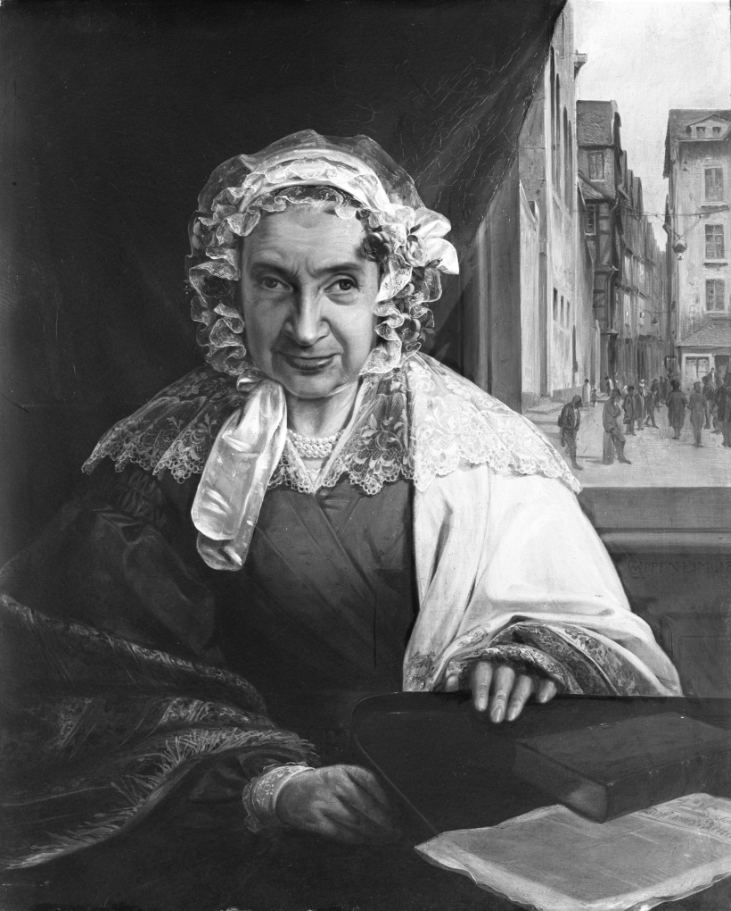
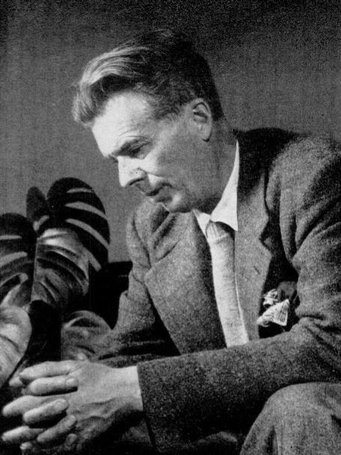
3.3.5 Historical facts: a non-mainstream narrative
„Give me control of a nation’s money, and I care not who makes its laws!”
Is the control of a nation’s money given?
thinking
Mayer Amschel Rothschild
(1744-1812)
HOW? „Do not take interest from an Israelite on anything, money or food or any other goods, which you let him have: From men of other nations you may take interest, but not from an Israelite:”
(Old Testament, Deuteronomy 23:19-20)
Gold standard
Robert Kennedy
(1925-1968)
John Fitzgerald Kennedy
(1917-1963)
Greenback
1861-1865
Modern credit money
Gold money
Gutle Schnapper
(M. A. Rothschild felesége)
1753-1849
$
„If my sons did not want wars, there would be none.”
XIV. Louis, Roi du soleil (1638-1715)
“In a capitalist democracy, … , never have so many been manipulated so much by so few.” (Brave New World Revisited, 1958)
Aldous Huxley
(1894-1963)
„L’Etat c’est moi”
Money power

Slide 38
EXERCICE Money creation
Exercice 1
Two tier banking system
Record the following activities (variations) in the balance sheets!
1/ Agent (A) takes a 100$ loan from commercial bank (A). We know that the obligatory reserve rate is 2% and bank (A) has no free reserves.
2/ Agent (A) transfers 100$ to agent (B), who has its accounts at commercial bank (B).
3/ Next day agent (B) withdraws 15$ from her account (thus to that time commercial bank A has already settled its debt).
4/ Agent (B) purchases from agent (A) for 85$ (pays with transfer). Agent (A) uses all her money to meet her debts included due interest (interest rate is 5%).
5/ Is it possible to reimburse the remaining 20$ loan?
Central Bank (CB)
RB+85
CBLA +100
RA+85
CBLA +15
C +15
Commercial Bank B (BB)
Commercial Bank A (BA)
Claim +20
CBLA+100
RB+85
+100
claim
CBLA +15
+85
D
RA+85
Individual wealth +5
RA+85
+85
D
Non bank agent B
Non bank agent A
C +15
+85
D
debt
+20
Debt
+100
+85
D

Slide 39
Exercice 2: Modern credit money system
Consider a two tier banking system with only digital currency (no cash). Government deficit is 100$ financed by treasury bonds; 80% issued to households and (20%) to commercial banks. The reserve ratio is 8% and can never drop below this level without causing the banking system’s disfunctioning. Register the events (variations: + increase; - decrease) (item name and amount) in accounts!
Emission of treasury bonds (help: similar to bank transfers)
Treasury spends
Commercial banks reimburse their debts

Slide 40
EXERCICE Money creation
Exercice 1
Two tier banking system
Record the following activities (variations) in the balance sheets!
1/ Agent (A) takes a 100$ loan from commercial bank (A). We know that the obligatory reserve rate is 2% and bank (A) has no free reserves.
2/ Agent (A) transfers 100$ to agent (B), who has its accounts at commercial bank (B).
3/ Next day agent (B) withdraws 15$ from her account (thus to that time commercial bank A has already settled its debt).
4/ Agent (B) purchases from agent (A) for 85$ (pays with transfer). Agent (A) uses all her money to meet her debts included due interest (interest rate is 5%).
5/ Is it possible to reimburse the remaining 20$ loan?
Central Bank (CB)
RB+85
CBLA +100
RA+85
CBLA +15
C +15
Commercial Bank B (BB)
Commercial Bank A (BA)
Claim +20
CBLA+100
RB+85
+100
claim
CBLA +15
+85
D
RA+85
Individual wealth +5
RA+85
+85
D
Non bank agent B
Non bank agent A
C +15
+85
D
debt
+20
Debt
+100
+85
D

Slide 41
Exercice 2: Modern credit money system
Consider a two tier banking system with only digital currency (no cash). Government deficit is 100$ financed by treasury bonds; 80% issued to households and (20%) to commercial banks. The reserve ratio is 8% and can never drop below this level without causing the banking system’s disfunctioning. Register the events (variations: + increase; - decrease) (item name and amount) in accounts!
Emission of treasury bonds (help: similar to bank transfers)
Treasury spends
Commercial banks reimburse their debts

Slide 42
Consider a two tier banking system with only digital currency (no cash). Government deficit is financed by treasury bonds; 60% issued to households and (40%) to commercial banks. The reserve ratio is 5% and can never drop below this level without causing the banking system’s disfunctioning. Banks never keep free reserves. We know that after having issued the government bonds and having spent 80% of it, the variation of demand deposits is 200$. Register the events (variations: + increase; - decrease) (item name and amount) in accounts!
Consider a two tier banking system. The cash to money ratio is 10%, the reserve ratio is 6% and can never drop below this level without causing the banking system’s disfunctioning. There are two commercial banks with a market share of 60%-40%. Both banks have 80$ free reserves. The little bank lends 800$ to its clients; the clients spend the money. Register the events (variations: + increase; - decrease) (item name and amount) in accounts if at the end there are no free reserves!
Consider a two tier banking system. The cash to money ratio is 10%, the reserve ratio is 5% and can never drop below this level without causing the banking system’s disfunctioning. There are two commercial banks with a market share of 60%-40%. Both banks have 80$ free reserves. The little bank lends to its clients; the clients spend the money and the end up with +900$ demand deposit. Register the events (variations: + increase; - decrease) (item name and amount) in accounts if at the end there are no free reserves!

Slide 43
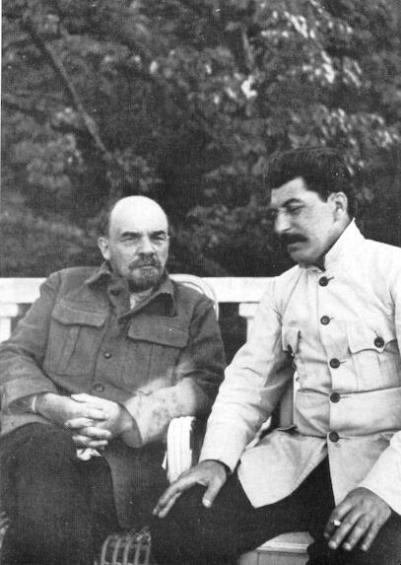
Understand the workings of the system that determines the accumulation of wealth in which we live
4. DESCRIPTION OF THE MODERN MARKET ECONOMY
4. 1 Market economy: definition
What are the essential, i.e. DISTINCTIVE, characteristics (as opposed to other economic systems such as feudalism, socialism)?
Natural law versus SOCIAL RULE (institution) versus individual choice
Systemic characteristics do not depend on natural laws or individual choice!
1/ The description of the economy necessarily implies moral judgment.
because the functioning of the economy is not governed by divin (natural) laws but by social rules
ECONOMICS CAN BE DEGRADED TO SERVE IDEOLOGIES
2/ The workings of the socio-economic system cannot be understood in terms of individual choices.
Vlagyimir Iljics Uljanov
METHODOLOGICAL INDIVIDUALISM, BEHAVIOURAL ECONOMICS ARE USELESS FOR THIS PURPOSE
Joszif Visszarionovics Dzsugasvili

Slide 44
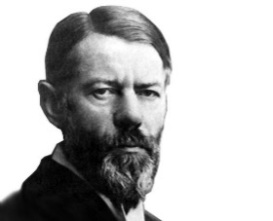
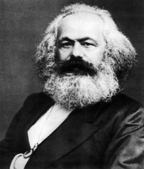
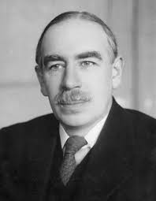
4. 1 Market economy: definition
Aim: study of wealth accumulation → Primary question: what are the modalities of wealth accumulation? (2.2)
Karl Marx
►The creation of social wealth essentially follows a CHREMATISTIC logic.
Max Weber
►individual and social wealth are different in nature (2.1)
►there is money
► there is private property
J. Maynard Keynes
Other characteristics that seem important:
► WAGED LABOUR
Mainstream economists
► FREE
Based on private property, no subordination by law and DECENTRALIZED
WAGED LABOUR, FREE, CHREMATISTIC ECONOMY

Slide 45

4.2 Economic theories in the light of the definition of market econoy
Waged labour | Free | Chrematistic | Monetary economy
x
x
x
x

Slide 46
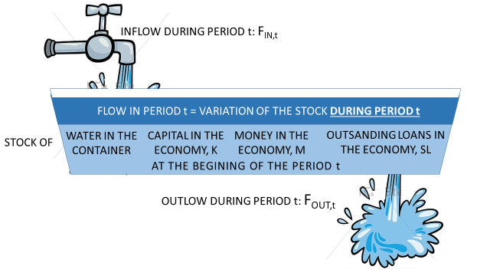
4.3 Accounting approaches / monetary analyis (individual and social wealth are different in nature
Mathematical representation of variations in discrete time
point in time t-1
Point in time t
Period t
S_{t-1}+ (F_{IN,t}-F_{OUT,t}) = S_{t}

Slide 47
4.3 Accounting approaches/ monetary analysis
Real analysis / value theories
Definitions: related to social rules that determine the variation of wealth (especially money)
Definitions are related to commodities
Household = Consumer…
Firm = Producer ….
 | Chrematistic |  | Non chrematistic
 | Can create money | Cannot create money | Can create money | Cannot create money
Do not make social rules (laws) | Commercial BANK | ENTREPRISE |  | HOUSEHOLD
Make social rules and enforce them |  |  | Central BANK | Government
Agents
Private agent
Public firm
State
STATE
Agent in private property
Public agent = agent in public property

Slide 48
4.3 Accounting approaches/ monetary analysis
Stock account
Stock account
Real asset
(VE_{t-1})
Individual
wealth
Real asset
(VE_{t})
Individual
wealth
Finanical
liability
(+VE_{t-1}+)
ΔEG_{t}
Finanical asset
ΔVE_{t}
Flow type accounts
Records changes in wealth resulting from
the activity of the agent in monetary terms
decreases increases
balance:
Finanical
liability
Finanical asset
Poin in time t-1
Point in time t
ΔEG_{t}
Stock type accounts
Records the variation in the form of wealth already acquired
Change in the stocks of real assets (Δ VE_{t})
Variation in individual wealth ΔEG_{t}
Change in the stocks of financial assets
Change in the stocks of financial liabilities
4.3.1 Business accounting

Slide 49
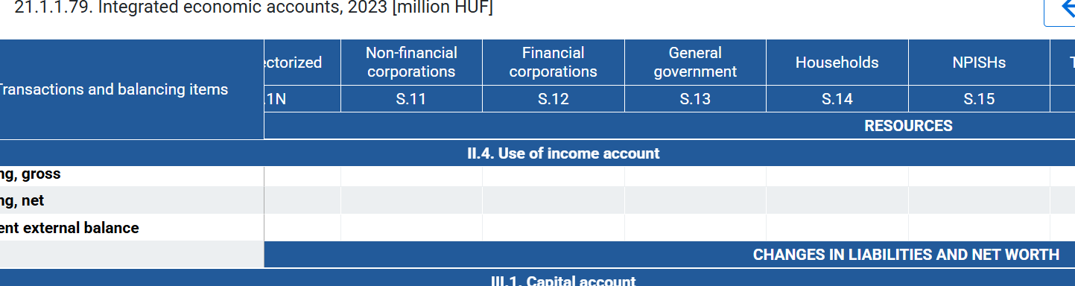
4.3.2 National accounting
Recording by the „income flow”
Account of 1 aggregated agent
Production account
Generation of income account
Allocation of primary income account
Secondary distribution of income account
Use of income account
Flow type accounts
Records changes in wealth resulting from
the activity of the agent in monetary terms
decreases increases
balance:
Stock type accounts
Records the variation in the form of wealth
already acquired in monetary terms
ΔEAssets ΔLiablities
Balance: ΔEG_{t}
Agent= sector (activity as main profile): Household, Financial corporations, Non-financial corporations, General governement, etc.

Slide 50
4.3.2. National accounting
Example: A firm sells for 100HUF to households a table, that costs 80HUF: 45HUF buys woodfrom another firm and pays 35HUF wage.
Income side recording
1HUF of expenditure is at the same time 1HUF of income: the double-entry bookkeeping is valid for two agents together.
1.Buying wood: Intermediate consumption CI 45HUF
2.Wage payment W 35HUF
3.Households purchase: Consumption C 100HUF
Firms
- Flow accounts +
Households
- Flow accounts +
1.45Ft CI
1.45Ft CI
3.100Ft C
3.100Ft C
NOTIONS DEFINED IN VALUE THEORY
2. 35Ft W
2. 35Ft W
CI: products totally used up in production during the period
C: satisfaction of need with goods
Notions: what do we have in accounting framework (monetary analysis)?
NO COMMODITY SPACE!!
Who pays to whom
Changes social wealth or not (change in real assets)
cost expenditure to execute a chrematistic (business) plan / non cost
We should define these notions differently…

Slide 51
4.3.2 National accounting: a mule
NOTIONS DEFINED IN VALUE THEORY
CI, C
Income side recording
Product side (use-ressource balance) recording
Society as a whole
branch a group of homogeneous production units which produce the same product from the other products of the nomenclature.
Flow type accounts
Records changes in wealth resulting from
the activity of the agent in monetary terms
decreases increases
TOTAL INCOME
= TOTAL PRODUCT
balance: ΔEG=S saving
P= CI+C+I
I: purchase of capital, capital …
P: outptu/production (market/non market)
CI
balance: GDP=C+I
C
GDP=P-CI=C+I
GDP: the value of the surplus (products) produced by the residents of a country at market prices during the year / total value added at market price
STOCK ACCOUNTS
Records the variation in the form of wealth
already acquired in monetary terms
ΔEAssets ΔLiabilities
balance: 0 (net lending/borrowing)
In total income there is no:
WAGE
INCOME from FINANCIAL OPERATIONS (ex. interest)
TAX
because…
ΔVE=I
S
I: … / expenditure in period t on which the chrematistic agent wants to realize the excess earning only in subsequent periods

Slide 52
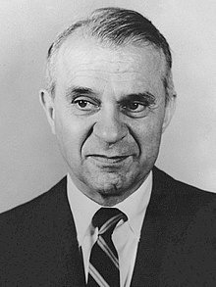
4.3.2.1. Economic theory independent application of the product side recording : the
LEONTIEF MODEL (Input – output model)
Income side recording
Product side (use-ressource balance) recording
1973 Nobel price
P= CI+C+I
 |  | 1.Branch Agriculture CI₁ | 2.Branch Industry CI₂ | Final use (C+I)
1. Product agriculture | P₁=p₁q₁ | p₁r₁₁q₁ | p₁r₁₂q₂ | p₁v₁=p₁(q₁-r₁₁q₁ -r₁₂q₂)
1.Product industry | P₂=p₂q₂ | p₂r₂₁q₁ | p₂r₂₂q₂ | p₂v₂=p₂(q₂-r₂₁q₁ -r₂₂q₂)
Value added | VA (h) | h₁q₁=(p₁-p₁r₁₁ -p₂r₂₁)q₁ | h₂q₂=(p₂-p₁r₁₂ -p₂r₂₂)q₂
 | P | P₁=p₁q₁ | P₂=p₂q₂
P₁ value of total product 1.
r₂₁production coefficient: the use in product 2. of the 1. branch
q₁ physical quantity of the 1. product
p₁ price of 1. product
R matrix of production coefficients
p price vector, q, v, h vectors
q =R*q+v
p =p*R+h
Practical questions:
If the output of a branch varies, what is the total change in output or imports it generates?
If the price of one product changes, how will this affect the price of other products?
effective rate of protection: If we impose tariffs on one product, how will that affect the competitiveness of other products?
Suppose production coefficients are FIX!

